Slide 1
CSE 10124 Embeddings 03

Slide 2
Logistics: Exam 01

Slide 3
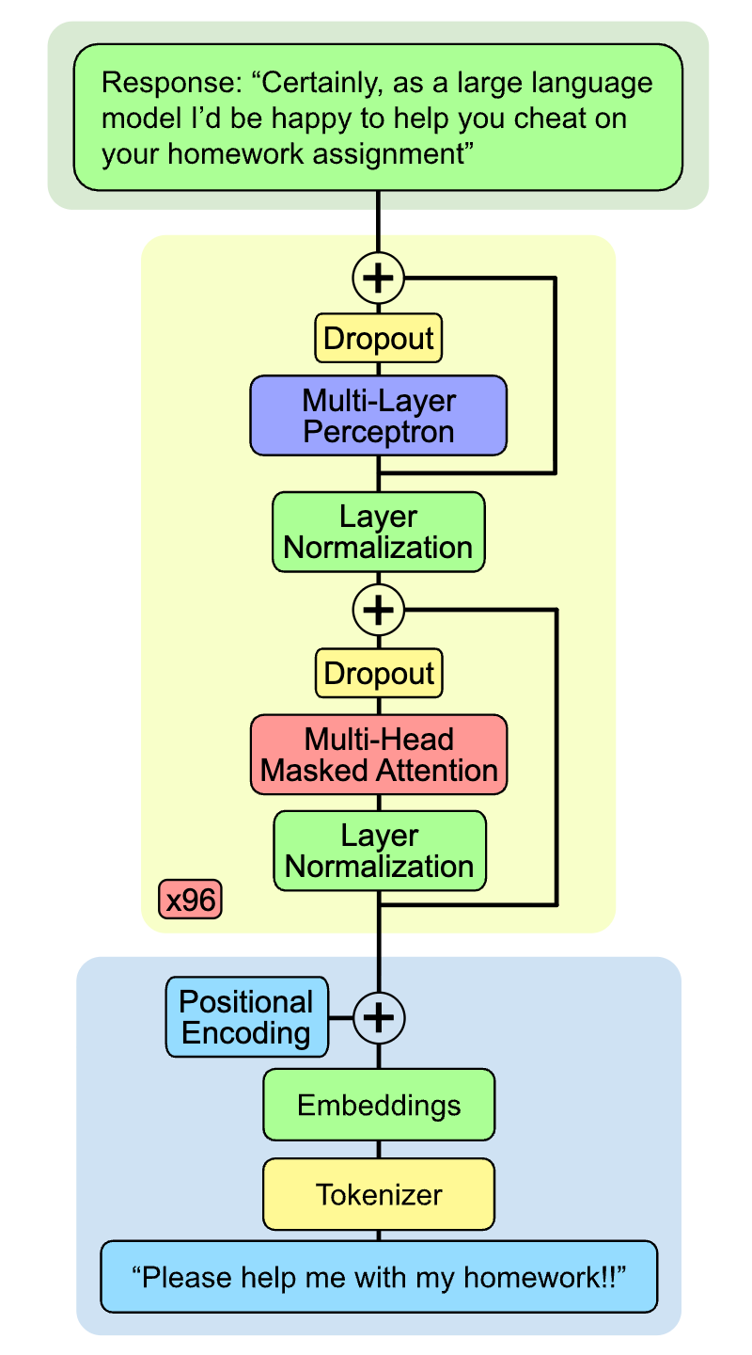
Where are we?
Today we’ll talk about linear transformations.
This is the process through which embeddings are actually created!

Slide 4
Training a Model
Ground Truth:
Hello there general
Prompt:
“Hello there”
Expected Output
<0.0, 1.0, 0.0, 0.0, 0.0, 0.0, 0.0, 0.0, 0.0, 0.0>
0 1 2 3 4 5 6 7 8 9
Tokens:
{“hello”: 3, “there”: 7}
Embeddings:
{3: <0.4, 0.3, …, -0.02>
7: <0.27, 0.8, …, 0.06>}
Cross Entropy Loss
= 1.97
Magic Box
SLM
Predicted Output
Predicted Output:
<0.19, 0.14, …, 0.08>
<0.19, 0.14, 0.12, 0.10, 0.09, 0.08, 0.07, 0.06, 0.07, 0.08>
0 1 2 3 4 5 6 7 8 9

Slide 5
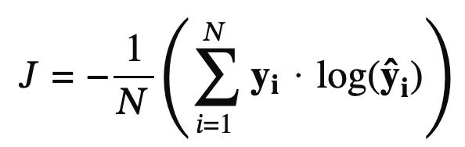
Deep Learning: Loss Functions
A loss function allows us to numerically measure how far off our model’s predicted values are from what we expected them to be, or what we know the right answer is.
Cross-Entropy: The loss function used to train LLMs is called “Cross-Entropy Loss” and it’s one of the most common loss functions. Heavily based on the principle of “entropy” as used in Information Theory, it’s a measure of how surprising our answer is relative to our ground-truth based on the entropy formula: -∑ p(x)log₂p(x)
Mostly outside the scope of the class, but it’s really not that complicated.

Slide 6
Text Generation
Prompt:
“Hello there”
Predicted Output
Tokens:
{“hello”: 3, “there”: 7}
<0.19, 0.14, 0.12, 0.10, 0.09, 0.08, 0.07, 0.06, 0.07, 0.08>
0 1 2 3 4 5 6 7 8 9
Embeddings:
{3: <0.4, 0.3, …, -0.02>
7: <0.27, 0.8, …, 0.06>}
Vocab
{0: “general”, 1: “bill”, 2: “kenobi”, 3: ”hello”, 4: “kitty”,
5: “mom”, 6: “dad”, 7: “there”, 8: “big”, 9: “bill”}
Magic Box
SLM
Output:
“Hello there” + “general”
Predicted Output:
<0.19, 0.14, …, 0.08>

Slide 7
Input and Output Embeddings
Prompt:
“Hello there”
Tokens:
{“hello”: 3}
Embeddings:
3: <1, 1024>
Embeddings:
{3: <0.4, 0.3, …, -0.02>}
Somehow in here our
embedding changes from:
(1, 1024) to (1, 10)
Magic Box
SLM
Predicted Output
Predicted Output:
<0.19, 0.14, …, 0.08>
<0.19, 0.14, 0.12, 0.10, 0.09, 0.08, 0.07, 0.06, 0.07, 0.08>
0 1 2 3 4 5 6 7 8 9

Slide 8
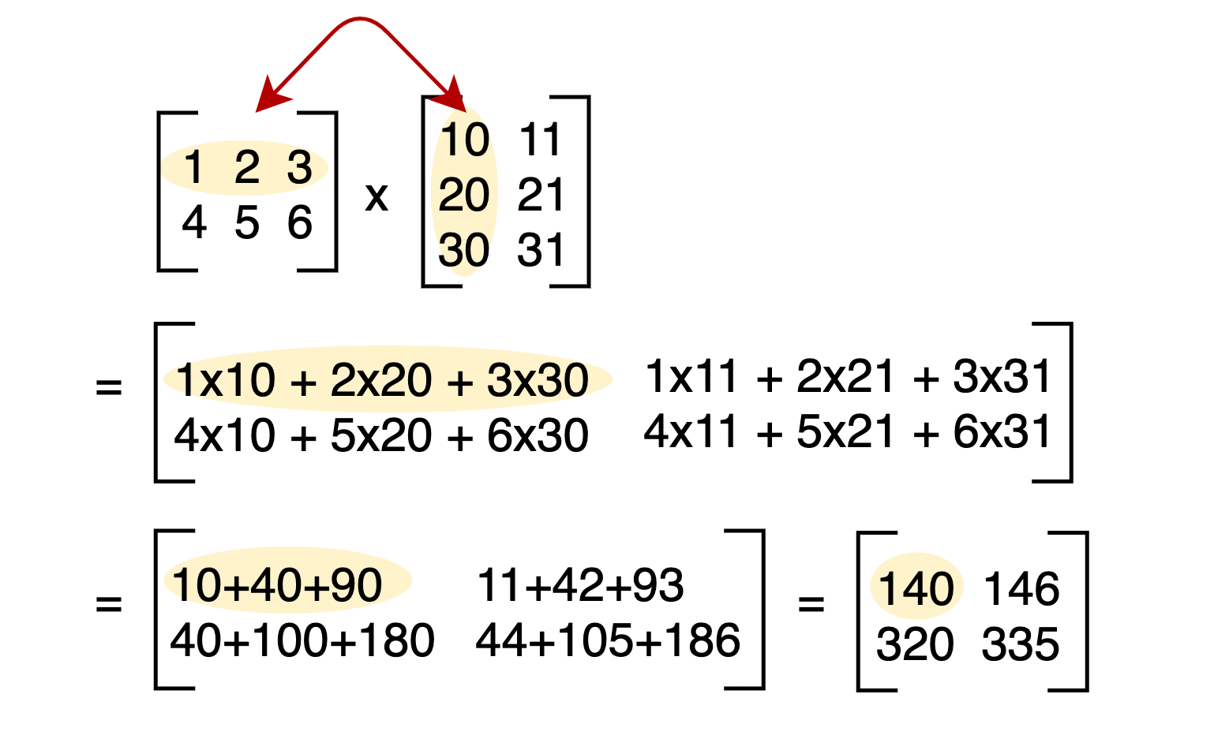
Matrix Multiplications

Slide 9
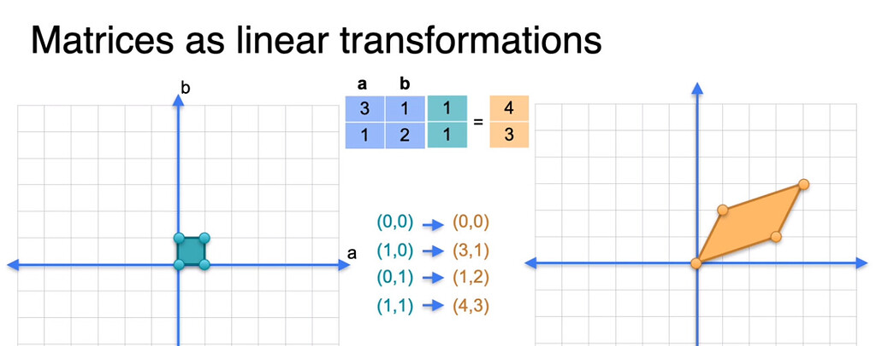
Linear Transformations

Slide 10
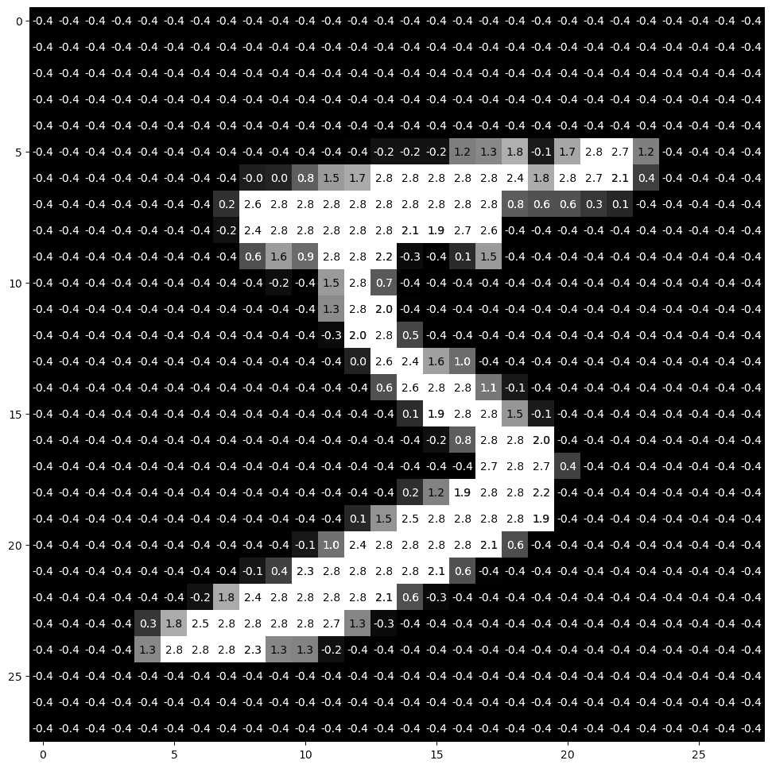
Writing MNIST “Equations”

Slide 11
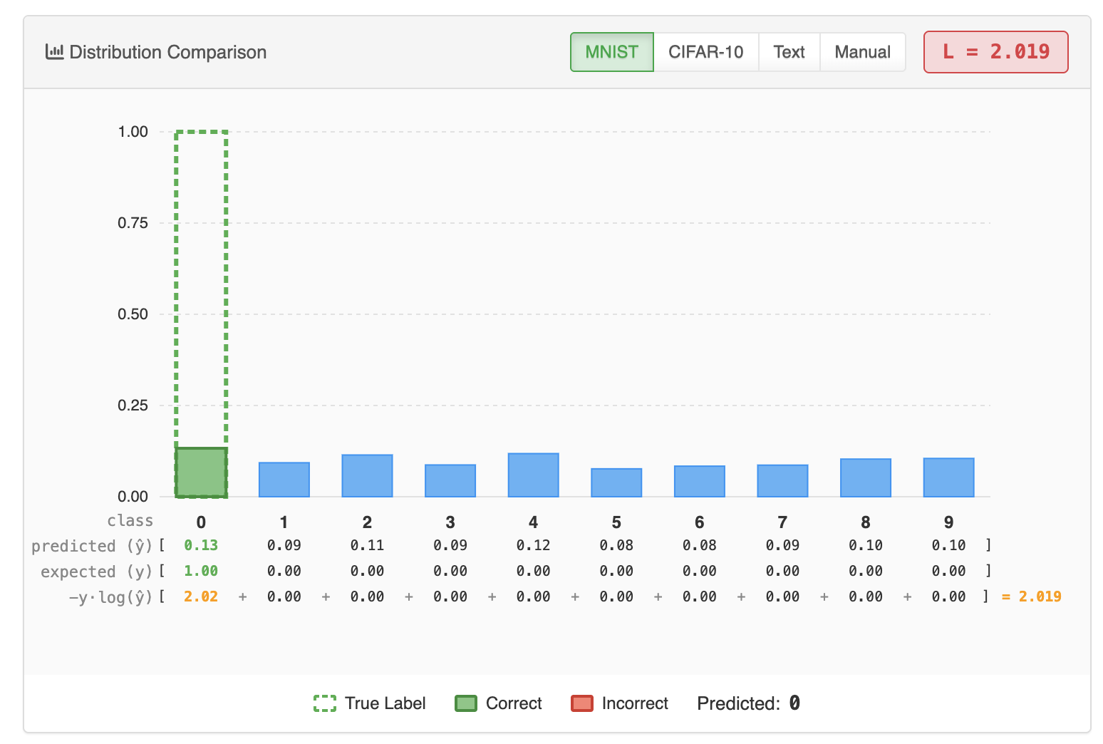
Visualizations

